Slide 1
Unit Digit & No of Zeroes
By Aditya Sir (CSAT

Slide 2

The unit digit in the product ${122}^{173}$ is
2
b) 4
c) 6
d) 8

Slide 3
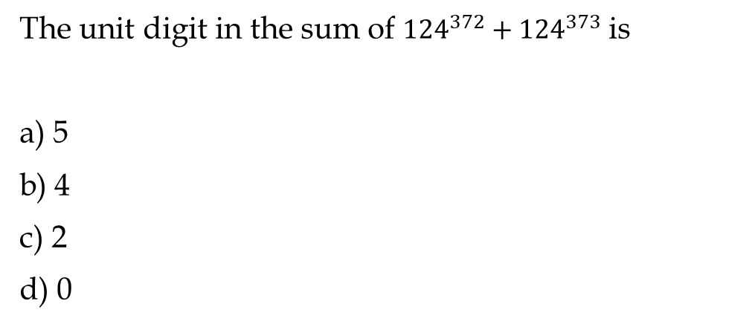
The unit digit in the sum of ${124}^{372}+{124}^{373}$ is
a) 5
b) 4
c) 2
d) 0

Slide 4
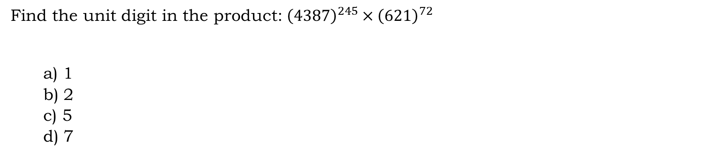
Find the unit digit in the product: ${\left(4387\right)}^{245}×{\left(621\right)}^{72}$
a) 1
b) 2
c) 5
d) 7

Slide 5
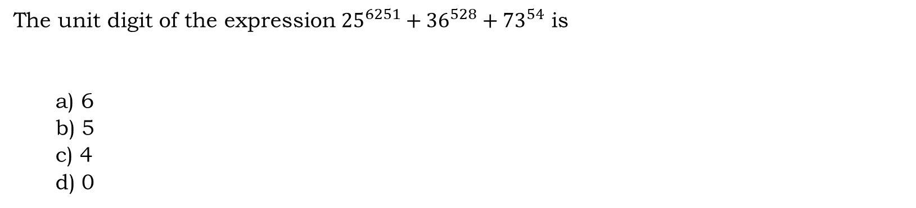
The unit digit of the expression ${25}^{6251}+{36}^{528}+{73}^{54}$ is
a) 6
b) 5
c) 4
d) 0

Slide 6
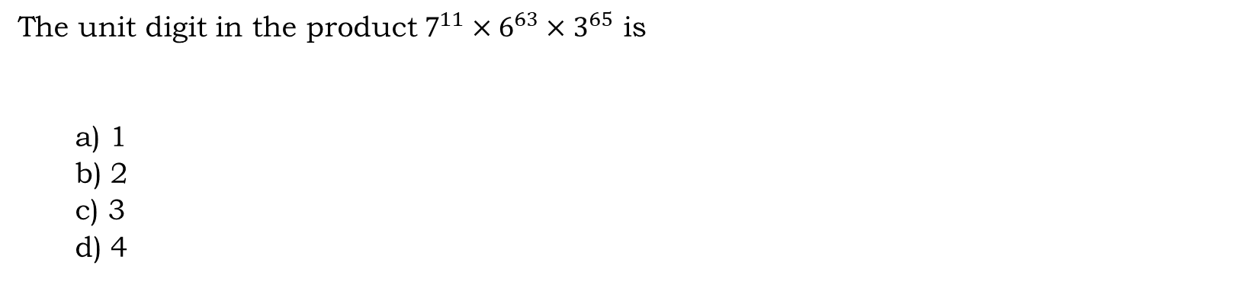
The unit digit in the product $7^{11}×6^{63}×3^{65}$ is
a) 1
b) 2
c) 3
d) 4

Slide 7
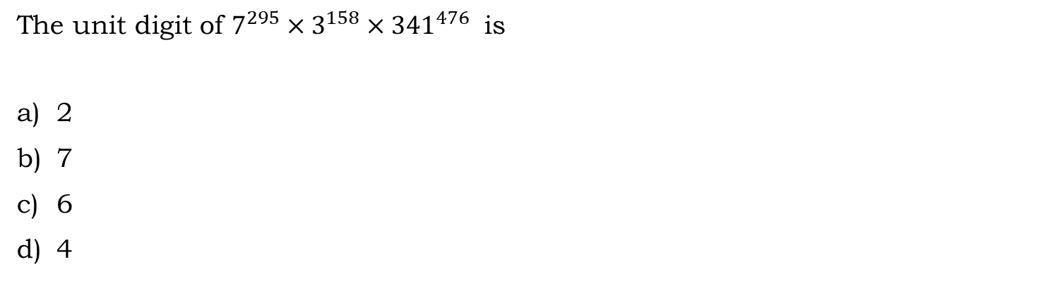
The unit digit of $7^{295}×3^{158}×{341}^{476}$ is
2
7
6
4

Slide 8
What is the unit digit of the sum of first 111 whole numbers?
a) 4
b) 6
c) 5
d) 0

Slide 9
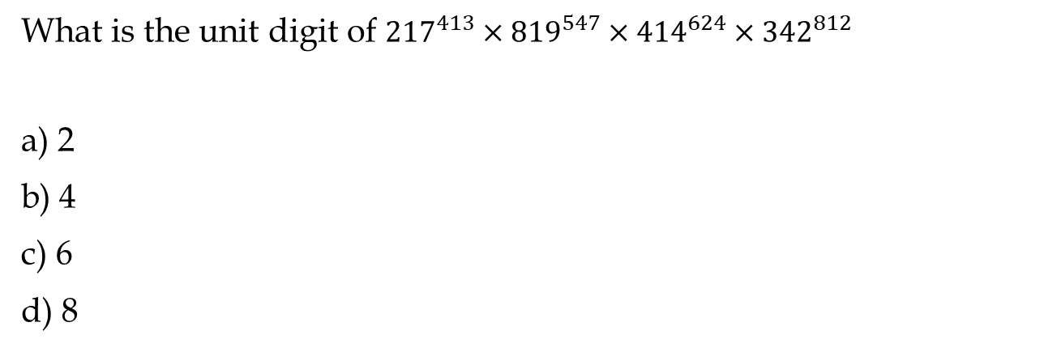
What is the unit digit of ${217}^{413}×{819}^{547}×{414}^{624}×{342}^{812}$
a) 2
b) 4
c) 6
d) 8

Slide 10
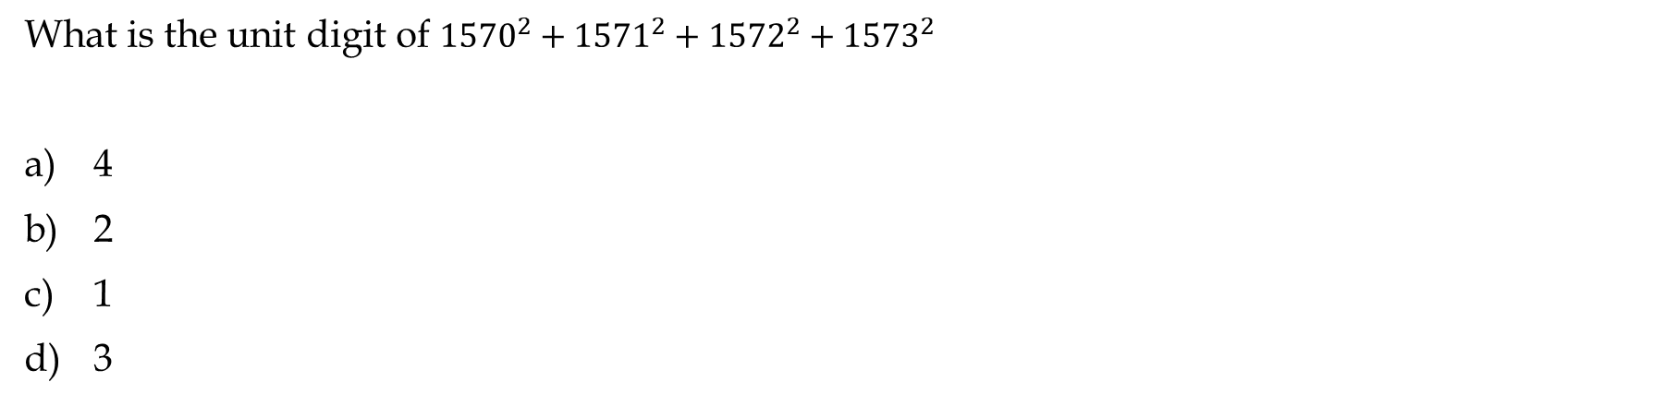
What is the unit digit of ${1570}^{2}+{1571}^{2}+{1572}^{2}+{1573}^{2}$
4
2
1
3

Slide 11
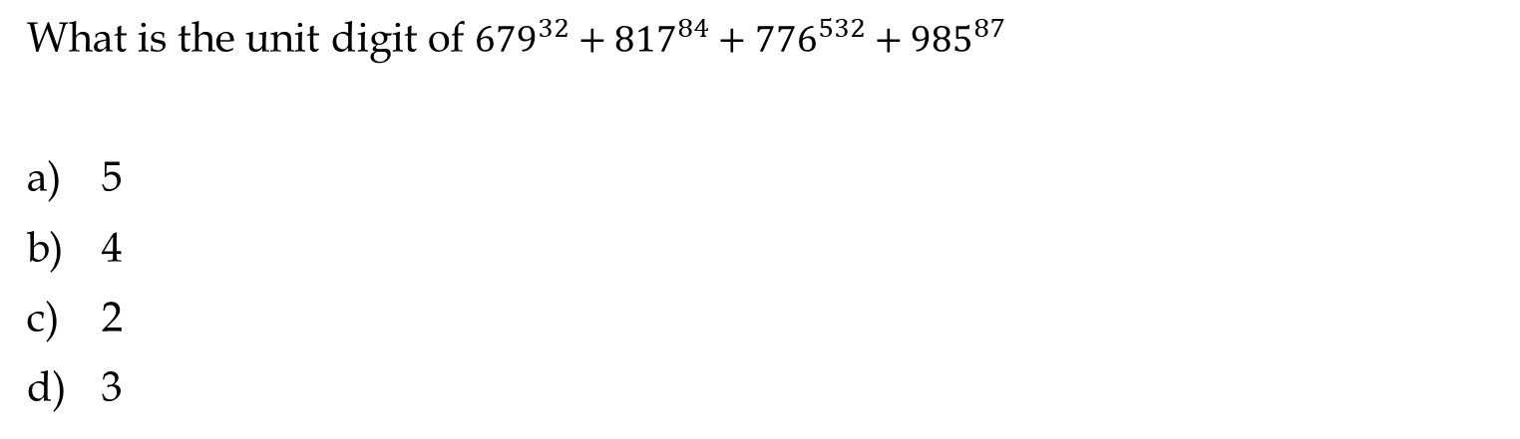
What is the unit digit of ${679}^{32}+{817}^{84}+{776}^{532}+{985}^{87}$
5
4
2
3

Slide 12
The unit digit of (433×456×43N) is (N+2), then what is the value of N?
1
8
3
6

Slide 13
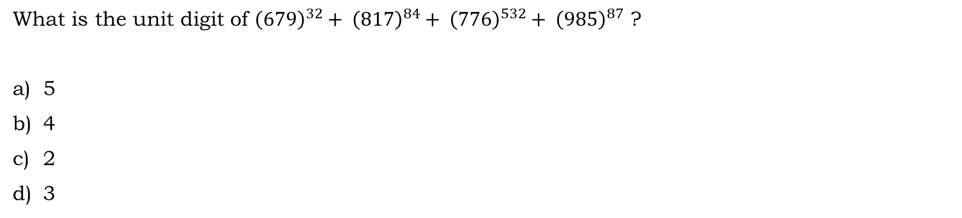
What is the unit digit of ${\left(679\right)}^{32}+ {\left(817\right)}^{84}+ {\left(776\right)}^{532}+ {\left(985\right)}^{87}$ ?
5
4
2
3

Slide 14
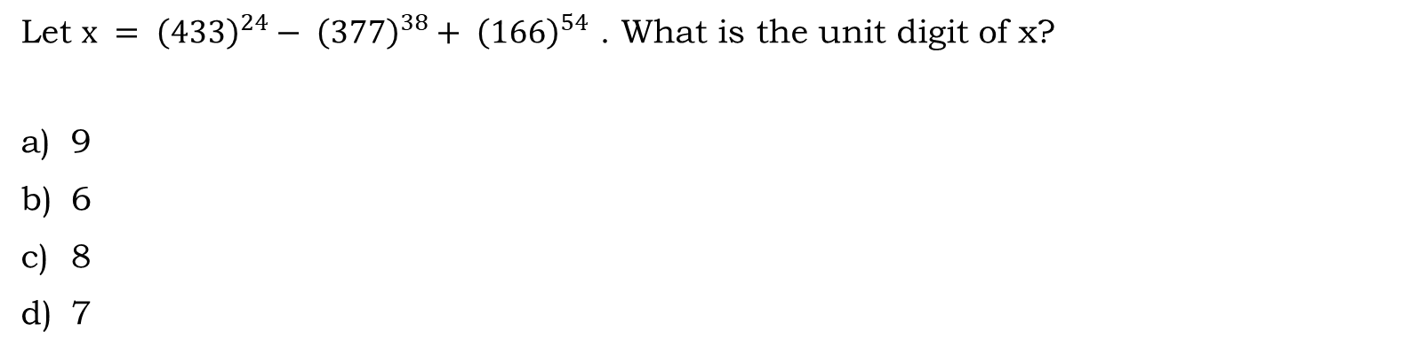
Let $x = {\left(433\right)}^{24}− {\left(377\right)}^{38}+ {\left(166\right)}^{54}$ . What is the unit digit of x?
9
6
8
7

Slide 15
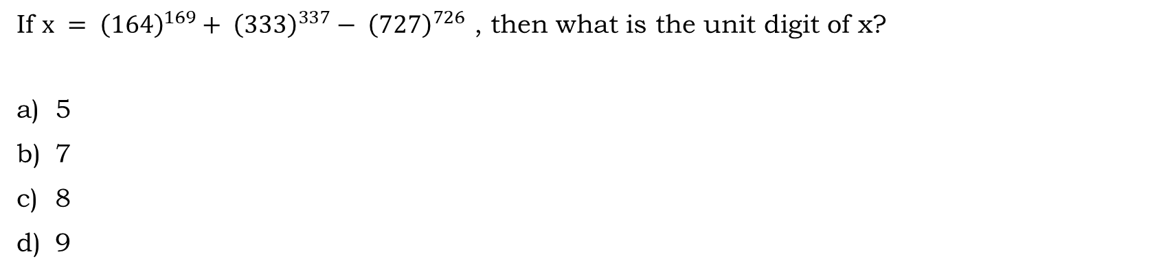
If $x = {\left(164\right)}^{169}+ {\left(333\right)}^{337}− {\left(727\right)}^{726}$ , then what is the unit digit of x?
5
7
8
9

Slide 16
The unit digit of the expression (1! + 2! + 3! + 4! + ……………….. +100!) × 3 is
3
9
6
0

Slide 17
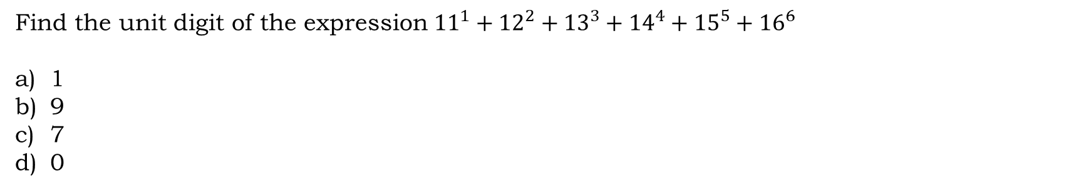
Find the unit digit of the expression ${11}^{1}+{12}^{2}+{13}^{3}+{14}^{4}+{15}^{5}+{16}^{6}$
1
9
7
0

Slide 18
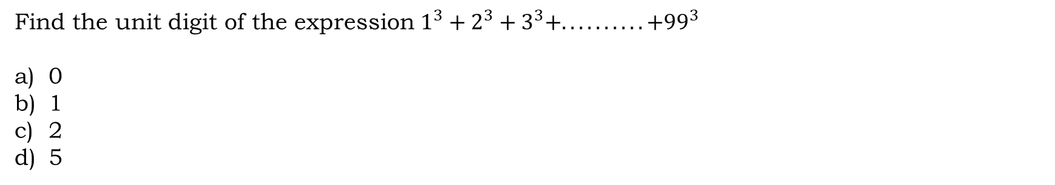
Find the unit digit of the expression $1^{3}+2^{3}+3^{3}+.. .. .. .. .. +{99}^{3}$
0
1
2
5

Slide 19
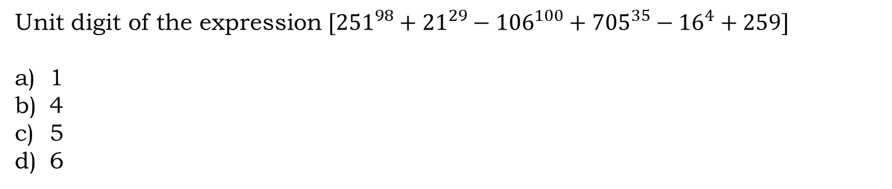
Unit digit of the expression $[{251}^{98}+{21}^{29}−{106}^{100}+{705}^{35}−{16}^{4}+259]$
1
4
5
6

Slide 20
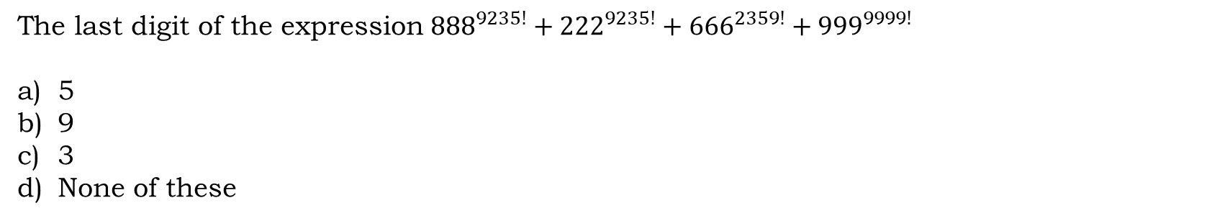
The last digit of the expression ${888}^{9235!}+{222}^{9235!}+{666}^{2359!}+{999}^{9999!}$
5
9
3
None of these

Slide 21
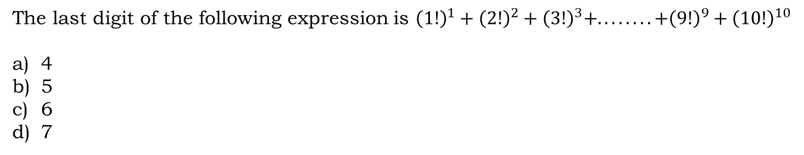
The last digit of the following expression is ${\left(1!\right)}^{1}+{\left(2!\right)}^{2}+{\left(3!\right)}^{3}+.. .. .. .. +{\left(9!\right)}^{9}+{\left(10!\right)}^{10}$
4
5
6
7

Slide 22
Find the number of zeroes at the end of the product 47!
8
9
10
11

Slide 23
Find the number of zeroes at the end of the product 378!
93
90
75
81

Slide 24
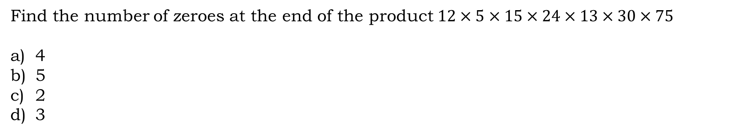
Find the number of zeroes at the end of the product $12×5×15×24×13×30×75$
4
5
2
3

Slide 25
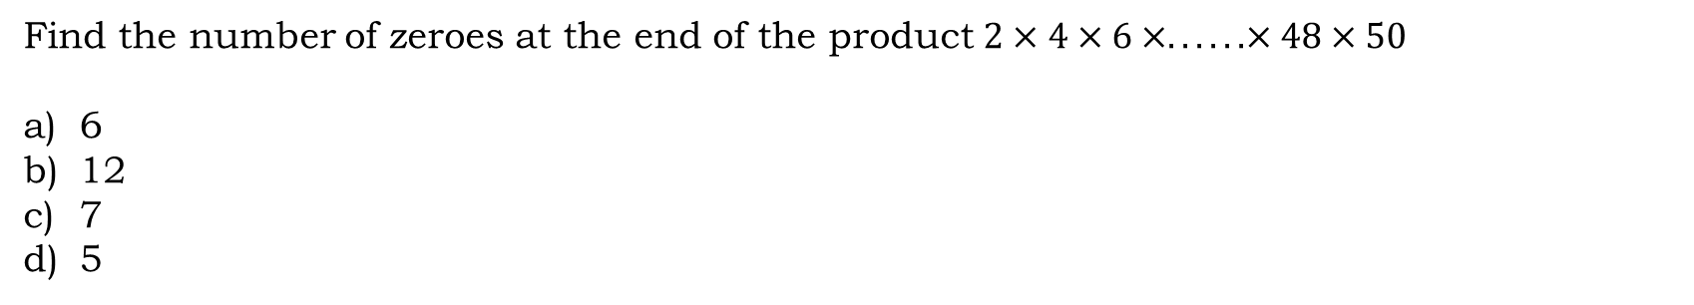
Find the number of zeroes at the end of the product $2×4×6×.. .. ..×48×50$
6
12
7
5

Slide 26
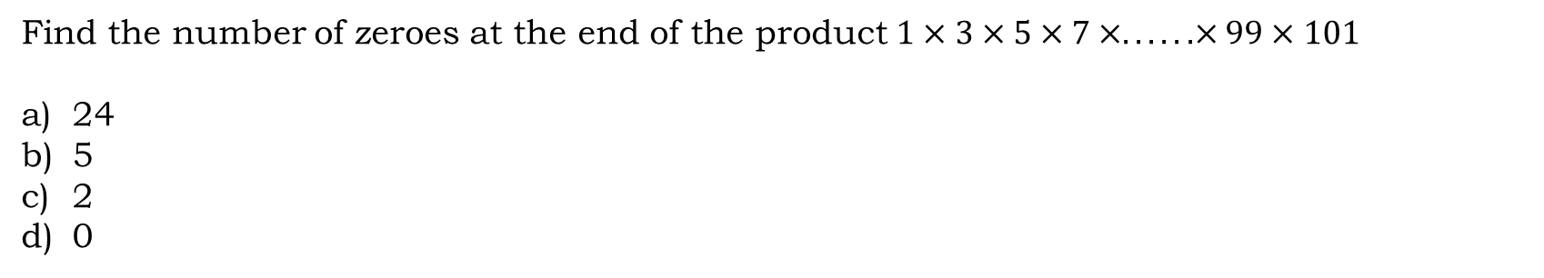
Find the number of zeroes at the end of the product $1×3×5×7×.. .. ..×99×101$
24
5
2
0

Slide 27
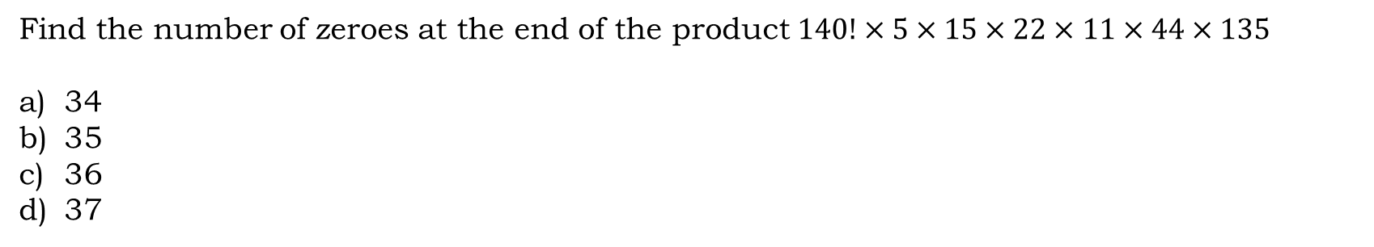
Find the number of zeroes at the end of the product $140!×5×15×22×11×44×135$
34
35
36
37

Slide 28
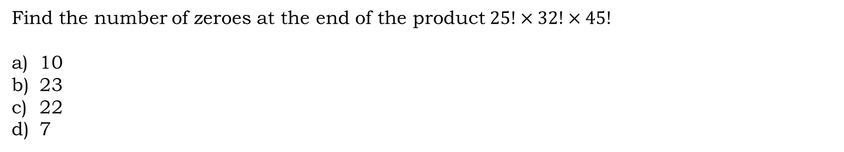
Find the number of zeroes at the end of the product $25!×32!×45!$
10
23
22
7

Slide 29
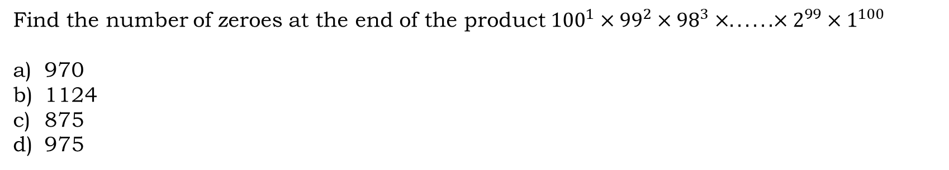
Find the number of zeroes at the end of the product ${100}^{1}×{99}^{2}×{98}^{3}×.. .. ..×2^{99}×1^{100}$
970
1124
875
975

Slide 30
Find the number of zeros at end of 5 x 10 x 15 x 20 x 25 x 30 x 35…………………………………… x 240 x 245 x 250
10
12
15
47

Slide 31
How many zeroes will be there at the end of 1007 × 1003× 1001 × 999 × …… × 123?
234
217
0
None of these

Slide 32
How many zeros will be there at the end of 10 × 25 × 35 × 40 × 50 × 60 × 65
7
6
9
5

Slide 33
Find the number of consecutive zeroes at the end of the given number (100! + 200!)
A) 73
B) 24
C) 11
D) 22

Slide 34
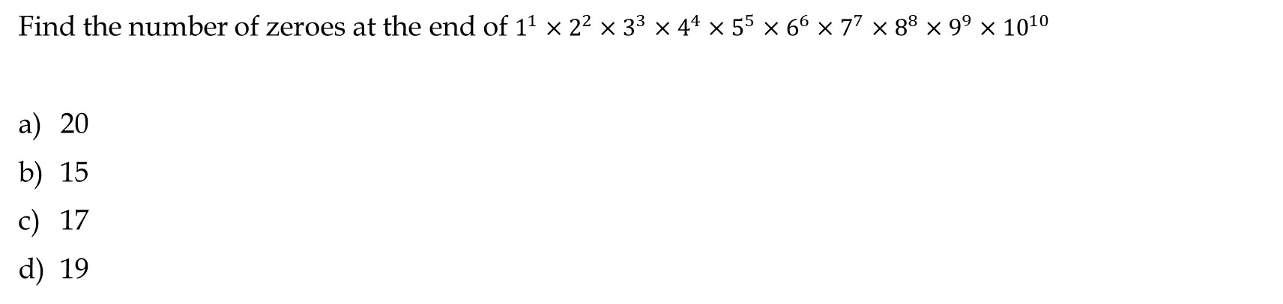
Find the number of zeroes at the end of $1^{1}×2^{2}×3^{3}×4^{4}×5^{5}×6^{6}×7^{7}×8^{8}×9^{9}×{10}^{10}$
20
15
17
19

Slide 35
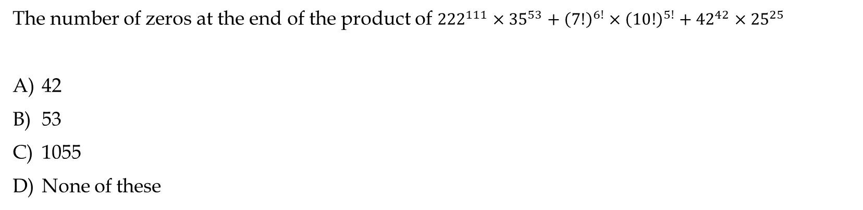
The number of zeros at the end of the product of ${222}^{111}×{35}^{53}+{\left(7!\right)}^{6!}×{\left(10!\right)}^{5!}+{42}^{42}×{25}^{25}$
42
53
1055
None of these

Slide 36
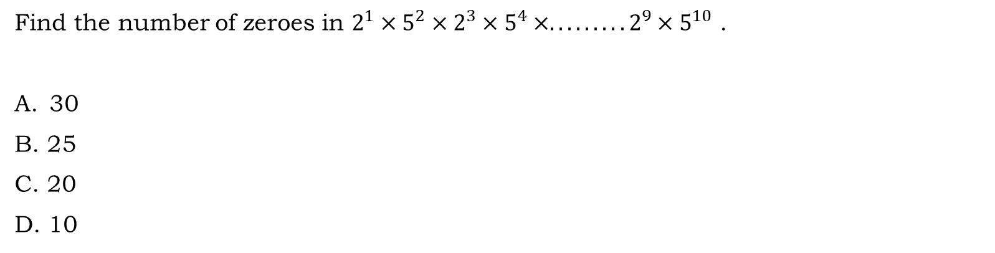
Find the number of zeroes in $2^{1}×5^{2}×2^{3}×5^{4}×.........2^{9}×5^{10}$ .
30
B. 25
C. 20
D. 10

Slide 37
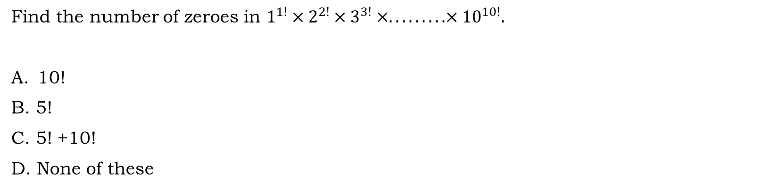
Find the number of zeroes in $1^{1!}×2^{2!}×3^{3!}×.........×{10}^{10!}.$
10!
B. 5!
C. 5! +10!
D. None of these

Slide 38
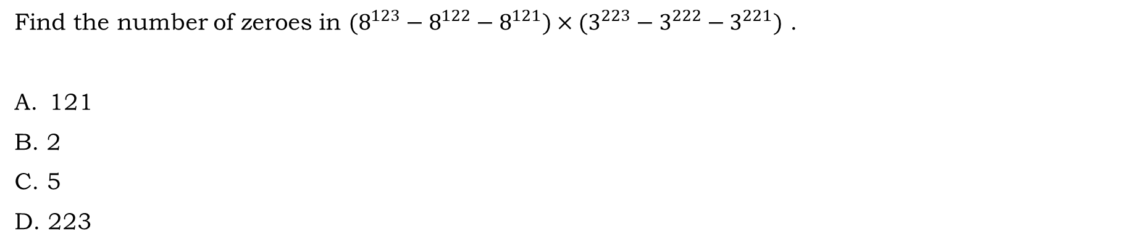
Find the number of zeroes in $(8^{123}−8^{122}−8^{121})×(3^{223}−3^{222}−3^{221})$ .
121
B. 2
C. 5
D. 223

Slide 39
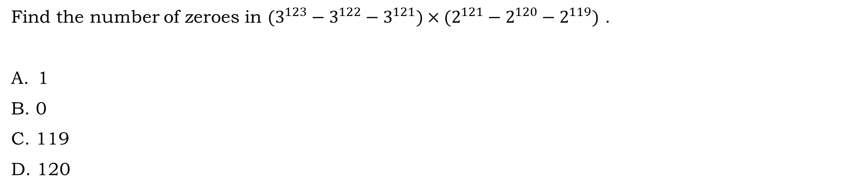
Find the number of zeroes in $(3^{123}−3^{122}−3^{121})×(2^{121}−2^{120}−2^{119})$ .
1
B. 0
C. 119
D. 120

